Slide 1
Music Recommendation System Mini Project Using Machine Learning
Group Members:
B. Sivarama Krishna(2022BCSE07AED368)
N. Hithesh Kumar(2022BCSE07AED370)
P .Anil (2022BCSE07AED551)

Slide 2
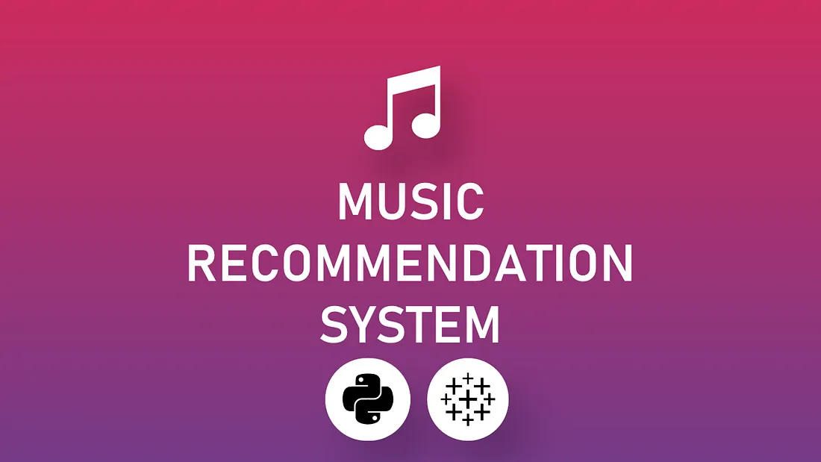
Introduction to Music Recommendation System Mini Project.
Music recommendation systems leverage machine learning algorithms to suggest personalized music to users.
These systems analyze user preferences, song features, and listening history to make accurate recommendations.
The goal of this mini project is to develop a prototype system that enhances user music discovery.
Notes:
Image source: https://towardsdatascience.com/create-music-recommendation-system-using-python-ce5401317159

Slide 3
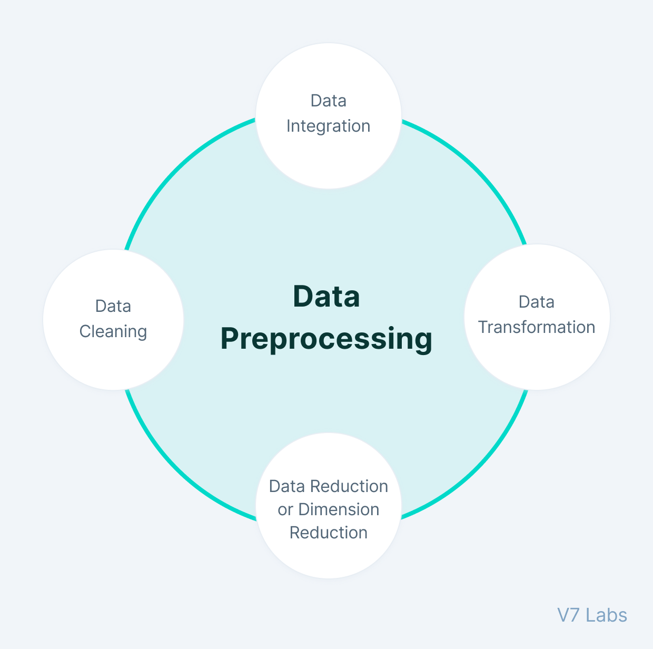
Data Collection and Preprocessing.
The project will involve collecting a dataset of user listening history and music features.
Data preprocessing techniques such as normalization and feature engineering will be applied to prepare the data for modeling.
The dataset will be split into training and testing sets for model evaluation.
Notes:
Image source: https://www.v7labs.com/blog/data-preprocessing-guide

Slide 4
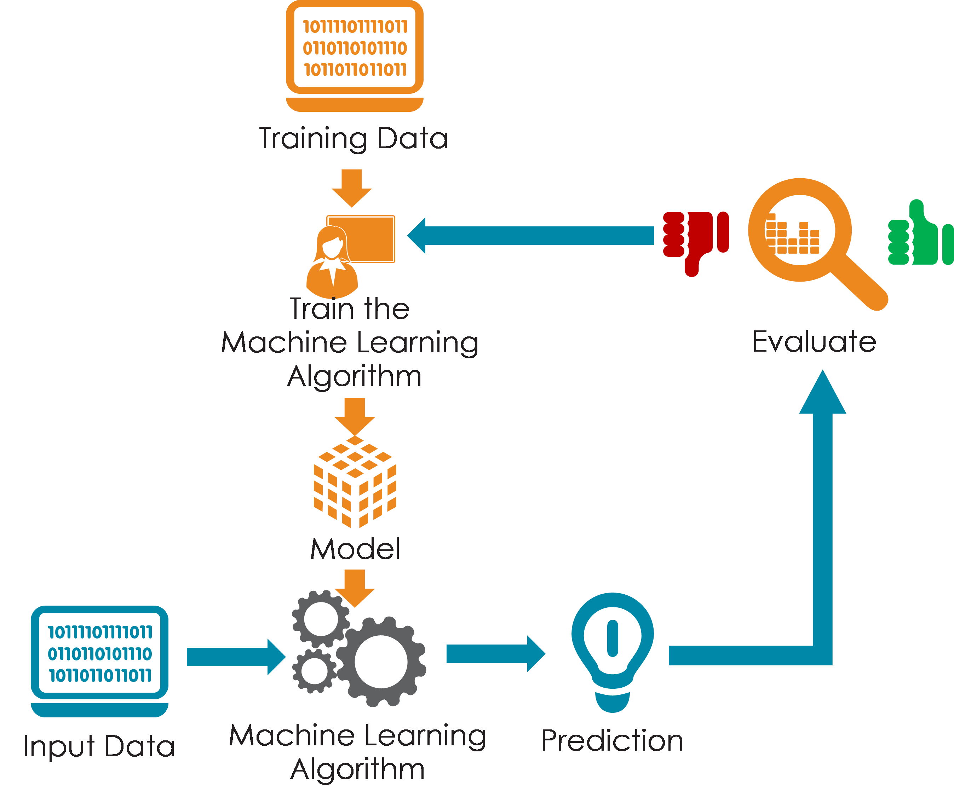
Building the Recommendation Model.
Various machine learning algorithms such as collaborative filtering and content-based filtering will be explored for recommendation.
The model will be trained on the training data and optimized using techniques like hyperparameter tuning.
Evaluation metrics like precision, recall, and F1-score will be used to assess the model's performance.
Notes:
Image source: https://www.pinterest.com/pin/704883779153047931/

Slide 5
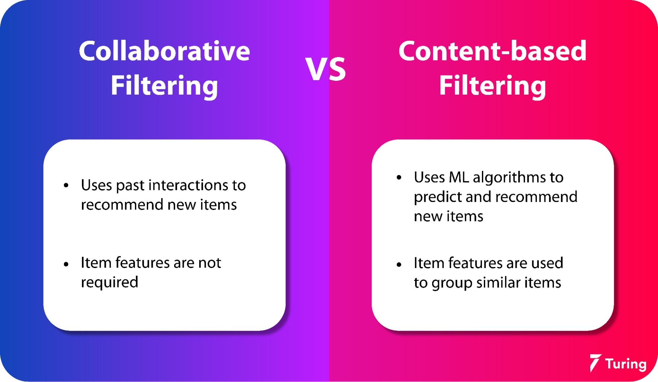
Collaborative Filtering Algorithm.
Collaborative filtering recommends music based on user behavior and preferences.
User-based and item-based collaborative filtering techniques will be implemented in the project.
The model will learn patterns from users with similar tastes to provide accurate recommendations.
Notes:
Image source: https://www.turing.com/kb/collaborative-filtering-in-recommender-system

Slide 6
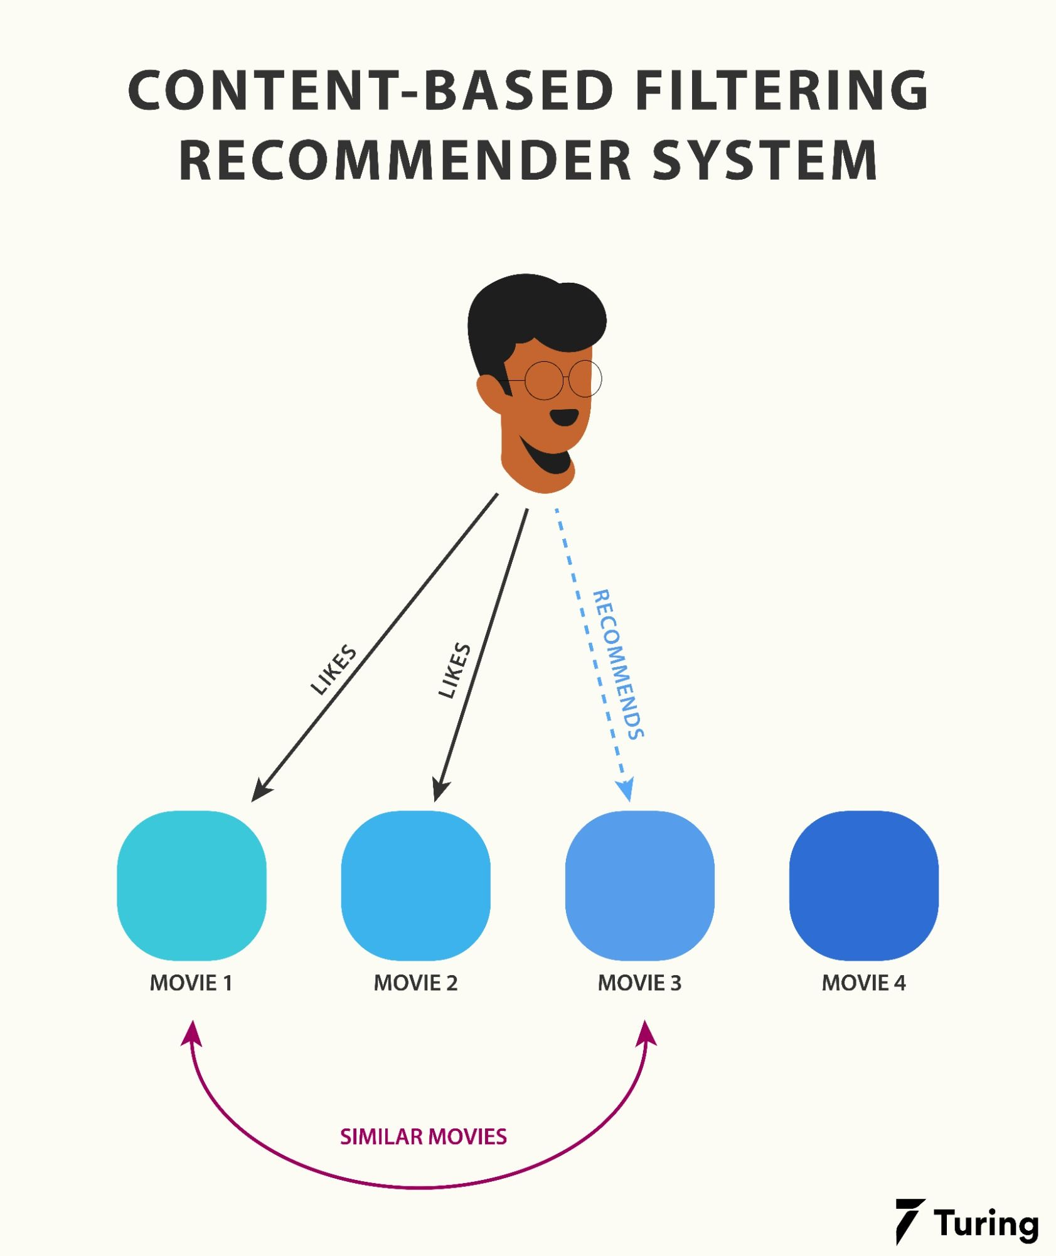
Content-Based Filtering Algorithm.
Content-based filtering recommends music based on the attributes of the songs themselves.
Features like genre, artist, tempo, and mood will be used to create music profiles.
The model will suggest music that aligns with the user's preferences and listening history.
Notes:
Image source: https://www.turing.com/kb/content-based-filtering-in-recommender-systems

Slide 7
Hybrid Recommendation Approach.
A hybrid recommendation approach combining collaborative filtering and content-based filtering will be explored.
This approach aims to leverage the strengths of both algorithms to provide more accurate recommendations.
By combining user behavior and song attributes, the system can offer diverse and personalized music suggestions.
Notes:
Image source: https://www.turing.com/kb/collaborative-filtering-in-recommender-system

Slide 8

User Interface Design.
The mini project will include designing a user-friendly interface for users to interact with the recommendation system.
Users can input preferences, view recommended playlists, and provide feedback on the suggestions.
The interface will enhance user experience and engagement with the music recommendations.
Notes:
Image source: https://www.freepik.com/blog/overview-basics-user-interface-design-uid/

Slide 9
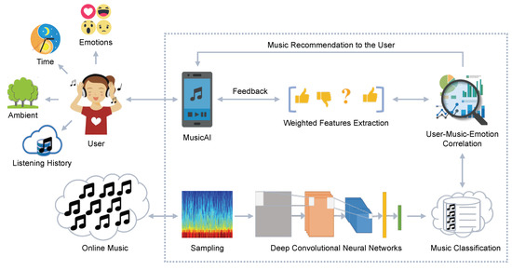
Deployment and Testing.
The recommendation system will be deployed on a web platform for users to access.
Extensive testing will be conducted to ensure the system's performance, scalability, and user satisfaction.
Feedback from users will be collected to continuously improve the recommendation system.
Notes:
Image source: https://www.researchgate.net/figure/Architecture-of-Proposed-Recommender-system_fig1_309673062

Slide 10

Future Enhancements and Scalability.
Future enhancements may include incorporating deep learning models for more sophisticated recommendations.
Scalability considerations will be addressed to handle large volumes of user data and music catalog.
Continuous monitoring and updating of the system will be essential for maintaining relevance and accuracy.
Notes:
Image source: https://www.pinterest.com/pin/387591111667627735/

Slide 11
Algorithm:
Pandas:
Pandas is a popular open-source data manipulation and analysis library for Python. It provides data structures and functions for efficiently handling and analyzing structured data. Some of the key components of Pandas include: DataFrame, Series, Indexing, Data Cleaning, Data Transformation etc.
Numpy:
NumPy, short for Numerical Python, is a powerful open-source library in Python used for numerical computing. It provides support for large, multi-dimensional arrays and matrices, along with a collection of mathematical functions to operate on these arrays efficiently. Some of the key features of NumPy include: Multi-dimensional arrays, Element-wise operations, Broadcasting, Vectorized operations, Linear algebra operations, Random number generation etc.
NLTK(Natural Language Toolkit):
NLTK stands for Natural Language Toolkit. It is a leading platform for building Python programs to work with human language data. NLTK provides easy-to-use interfaces to over 50 corpora and lexical resources such as WordNet, along with a suite of text processing libraries for classification, tokenization, stemming, tagging, parsing, and more. Here are some key features and functionalities of NLTK: Text Tokenization, Text Classification, Stemming and Lemmatization, Syntax Parsing etc.

Slide 12

Algorithm continuation:
Tokenization:
Tokenization is an essential step in natural language processing (NLP) that involves breaking down a text into individual tokens, which can be words, phrases, symbols, or other meaningful units. In the context of a music recommendation system, tokenization is often used to process text data such as song titles, artist names, album names, lyrics, user reviews, or genre descriptions.
Scikit-learn (sklearn):
Scikit-learn (sklearn) is a popular machine learning library in Python that provides a wide range of tools and algorithms for building machine learning models. It can be used in various aspects of such systems, especially for tasks like data preprocessing, feature extraction, and model building. Here's how you can use sklearn in Python for a basic music recommendation system: Data Preprocessing, Feature Extraction, Model Building etc.
Cosine similarity:
Cosine similarity is a metric used to measure the similarity between two vectors in a multidimensional space. In the context of a music recommendation system, cosine similarity can be applied to compute the similarity between songs or other music-related items based on their feature vectors. Python provides several libraries, such as NumPy and scikit-learn, that can be used to calculate cosine similarity efficiently.

Slide 13
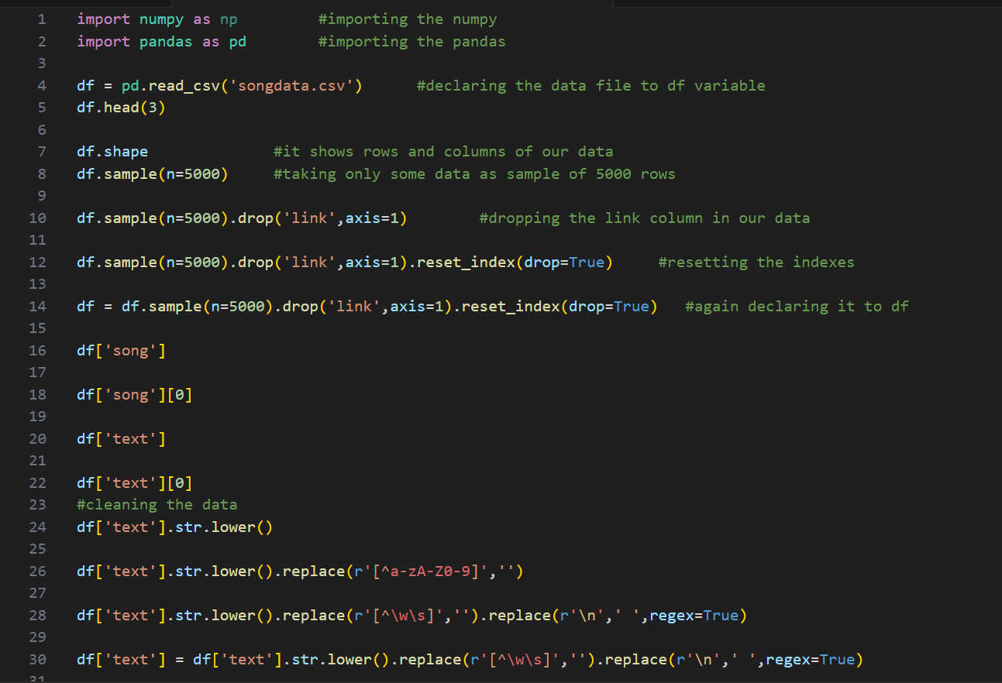
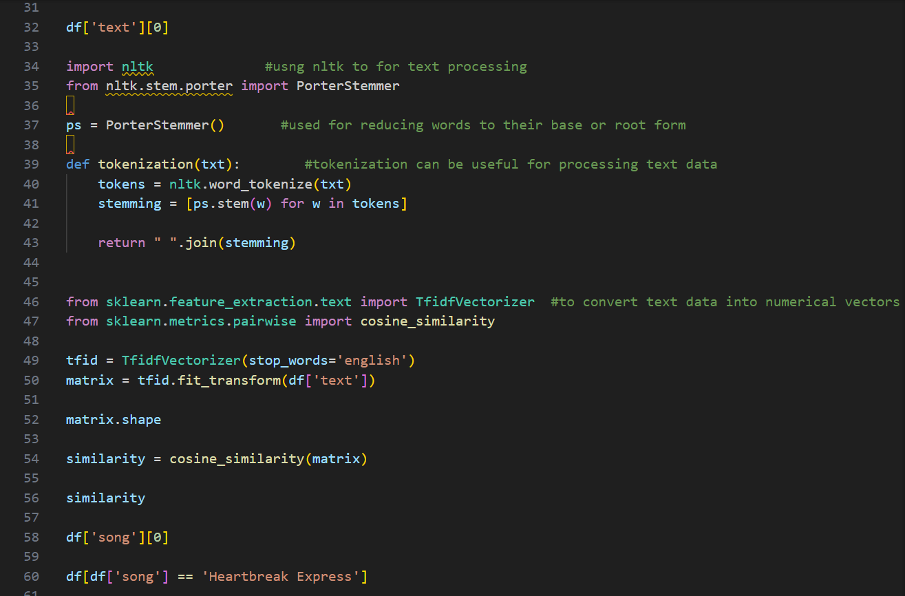
Program:

Slide 14
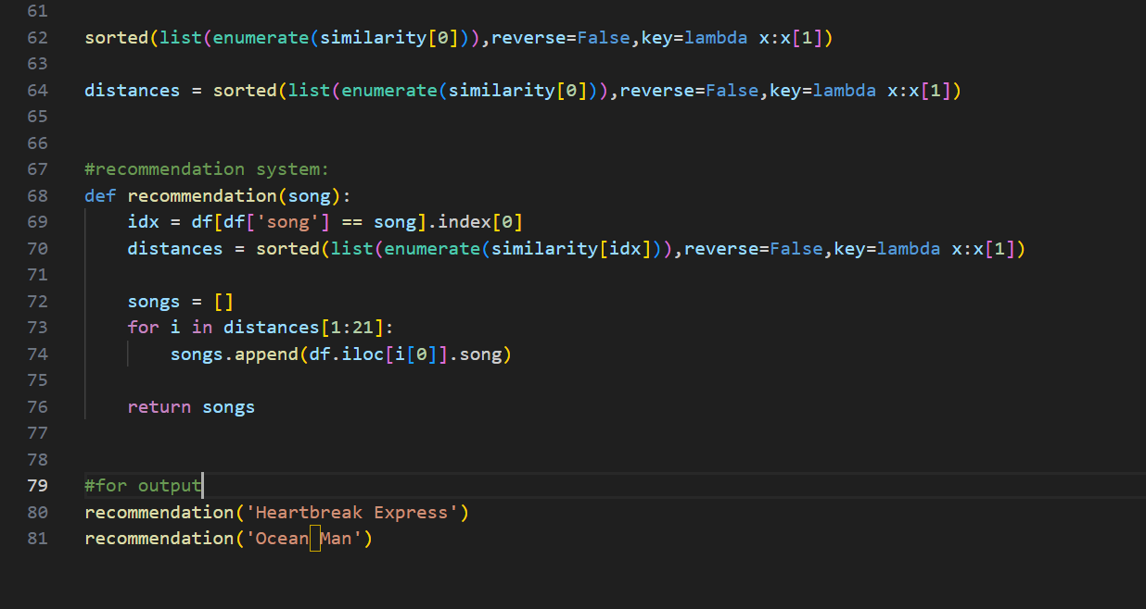
Program continuation:

Slide 15
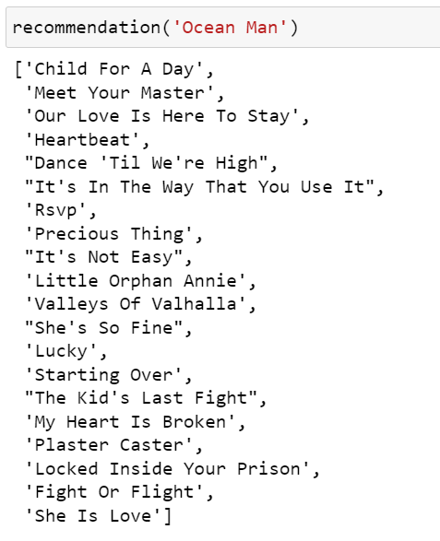
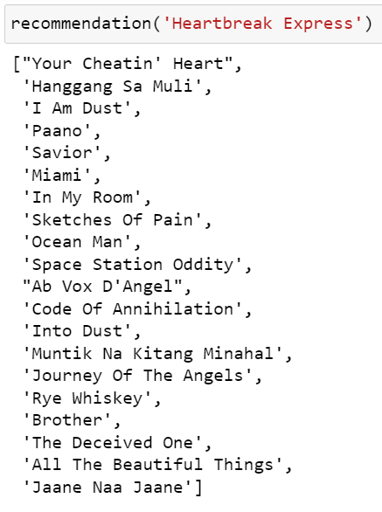
Overall Output: Recommending songs

Slide 16

Conclusion.
The music recommendation system mini project demonstrates the application of machine learning in enhancing user music discovery.
By leveraging collaborative filtering, content-based filtering, and hybrid approaches, the system provides personalized music suggestions.
The project showcases the potential of recommendation systems to improve user experience and engagement in the music streaming industry.
Notes:
Image source: https://towardsdatascience.com/create-music-recommendation-system-using-python-ce5401317159

Slide 17
References.
For Dataset: https://www.kaggle.com/datasets/noorsaeed/songs-recommendation-dataset
Youtube: youtube.com/watch?v=gb7EzyuNSxI&t=983s
ChatGPT
Google
Kaggle
Github
Geeksforgeeks etc…..
11

Slide 18

THANK YOU

